Slide 1
GE Washing Machine Teardown Report
Jude Elkins, Joshua Orlett, Mike Fallen

Slide 2
Components
Component List
Water Inlet
Agitator and Drum
Control Board
Sensors
Drain Pump
Drive Motor
Gearbox
Clutch

Slide 3
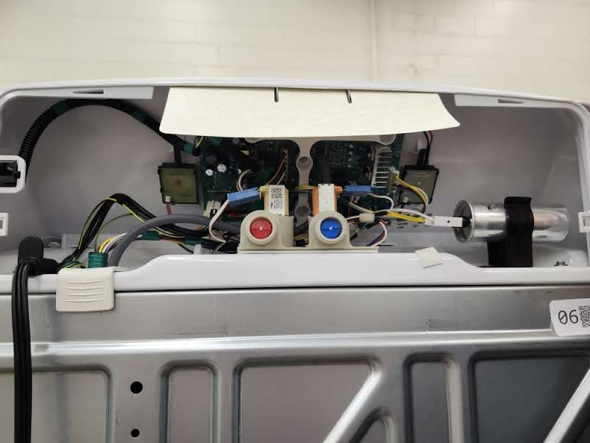
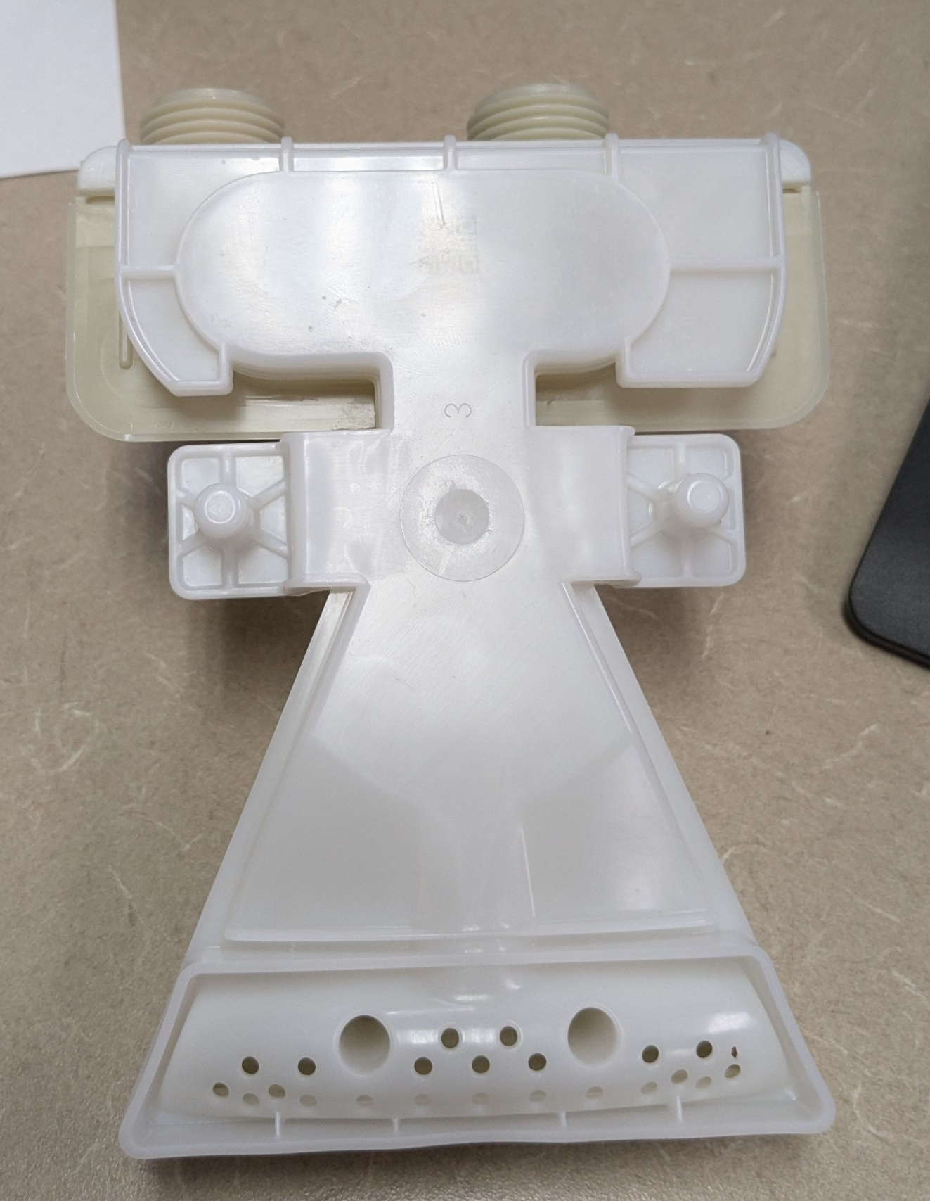
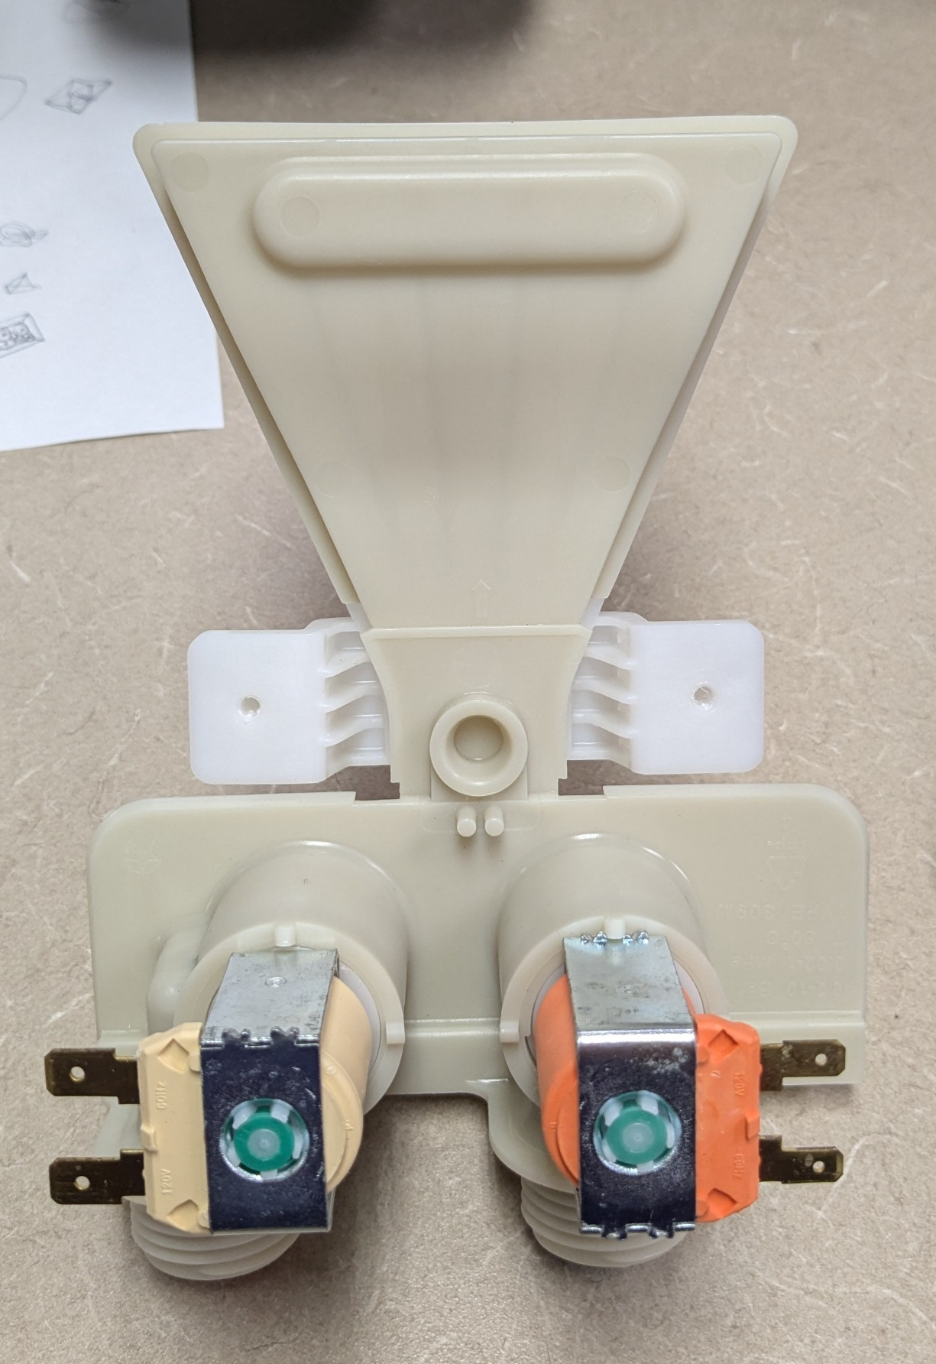
Water Inlet
The Inlet valve has two solenoids, one for hot, one for cold
No Temperature Sensor
All water goes straight into the wash tub

Slide 4
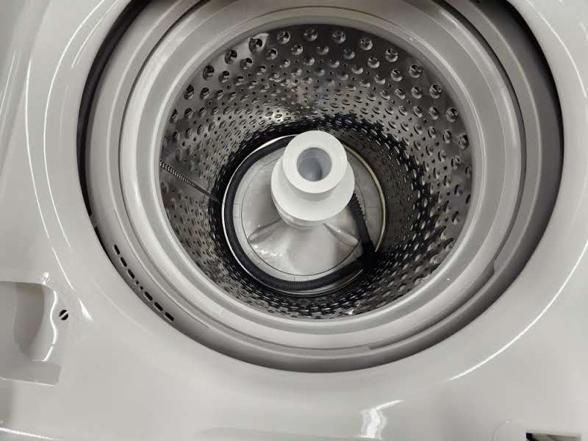
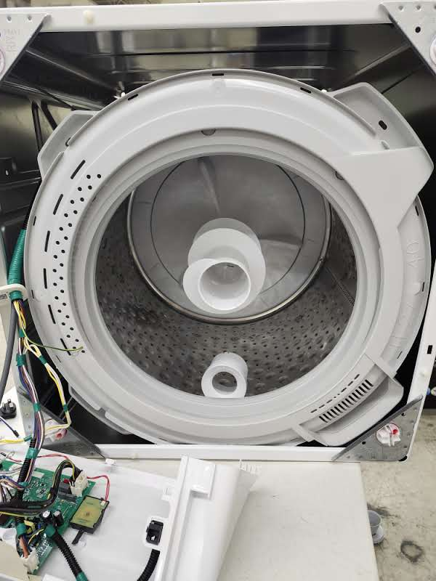
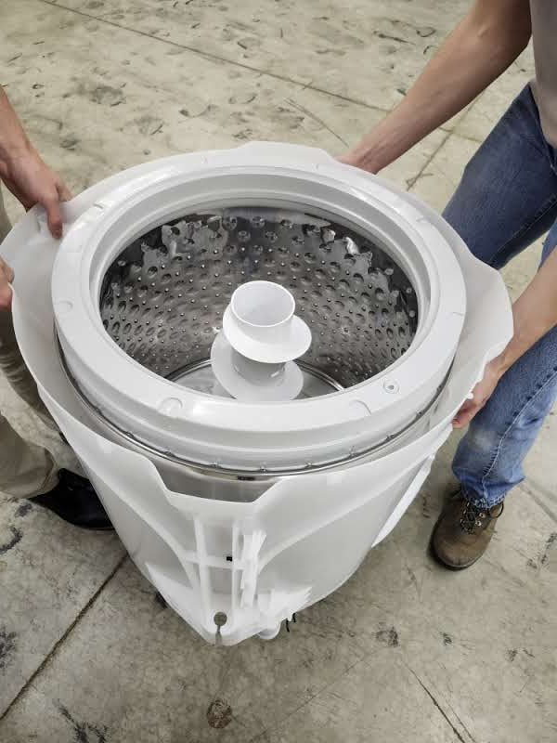
Agitator and Drum
The agitator and drum always rotate at the same time
The entire drum is contained inside a waterproof plastic tub
Mounted with four suspension arms to the main frame of the dishwasher
The Drum inside the watertight tub

Slide 5
Control Board
The control board is behind the control knobs
Contains all electronics for the washing machine
One very large capacitor that connects to the drive motor
The large capacitor could pose a safety issue as it caries a charge even after being unplugged

Slide 6
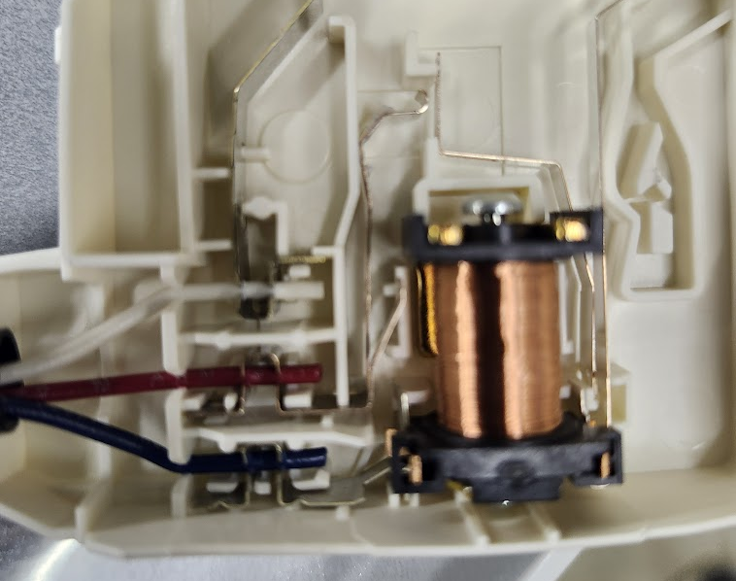
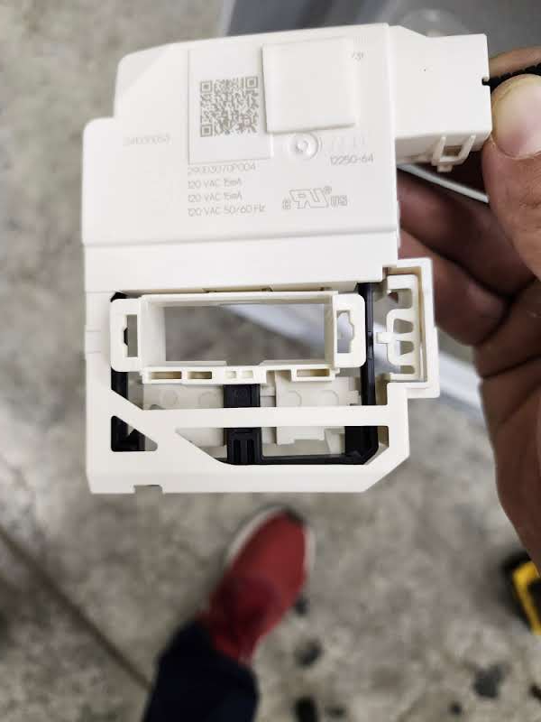
Door latch
Very simple small solenoid that latches the door closed when running

Slide 7
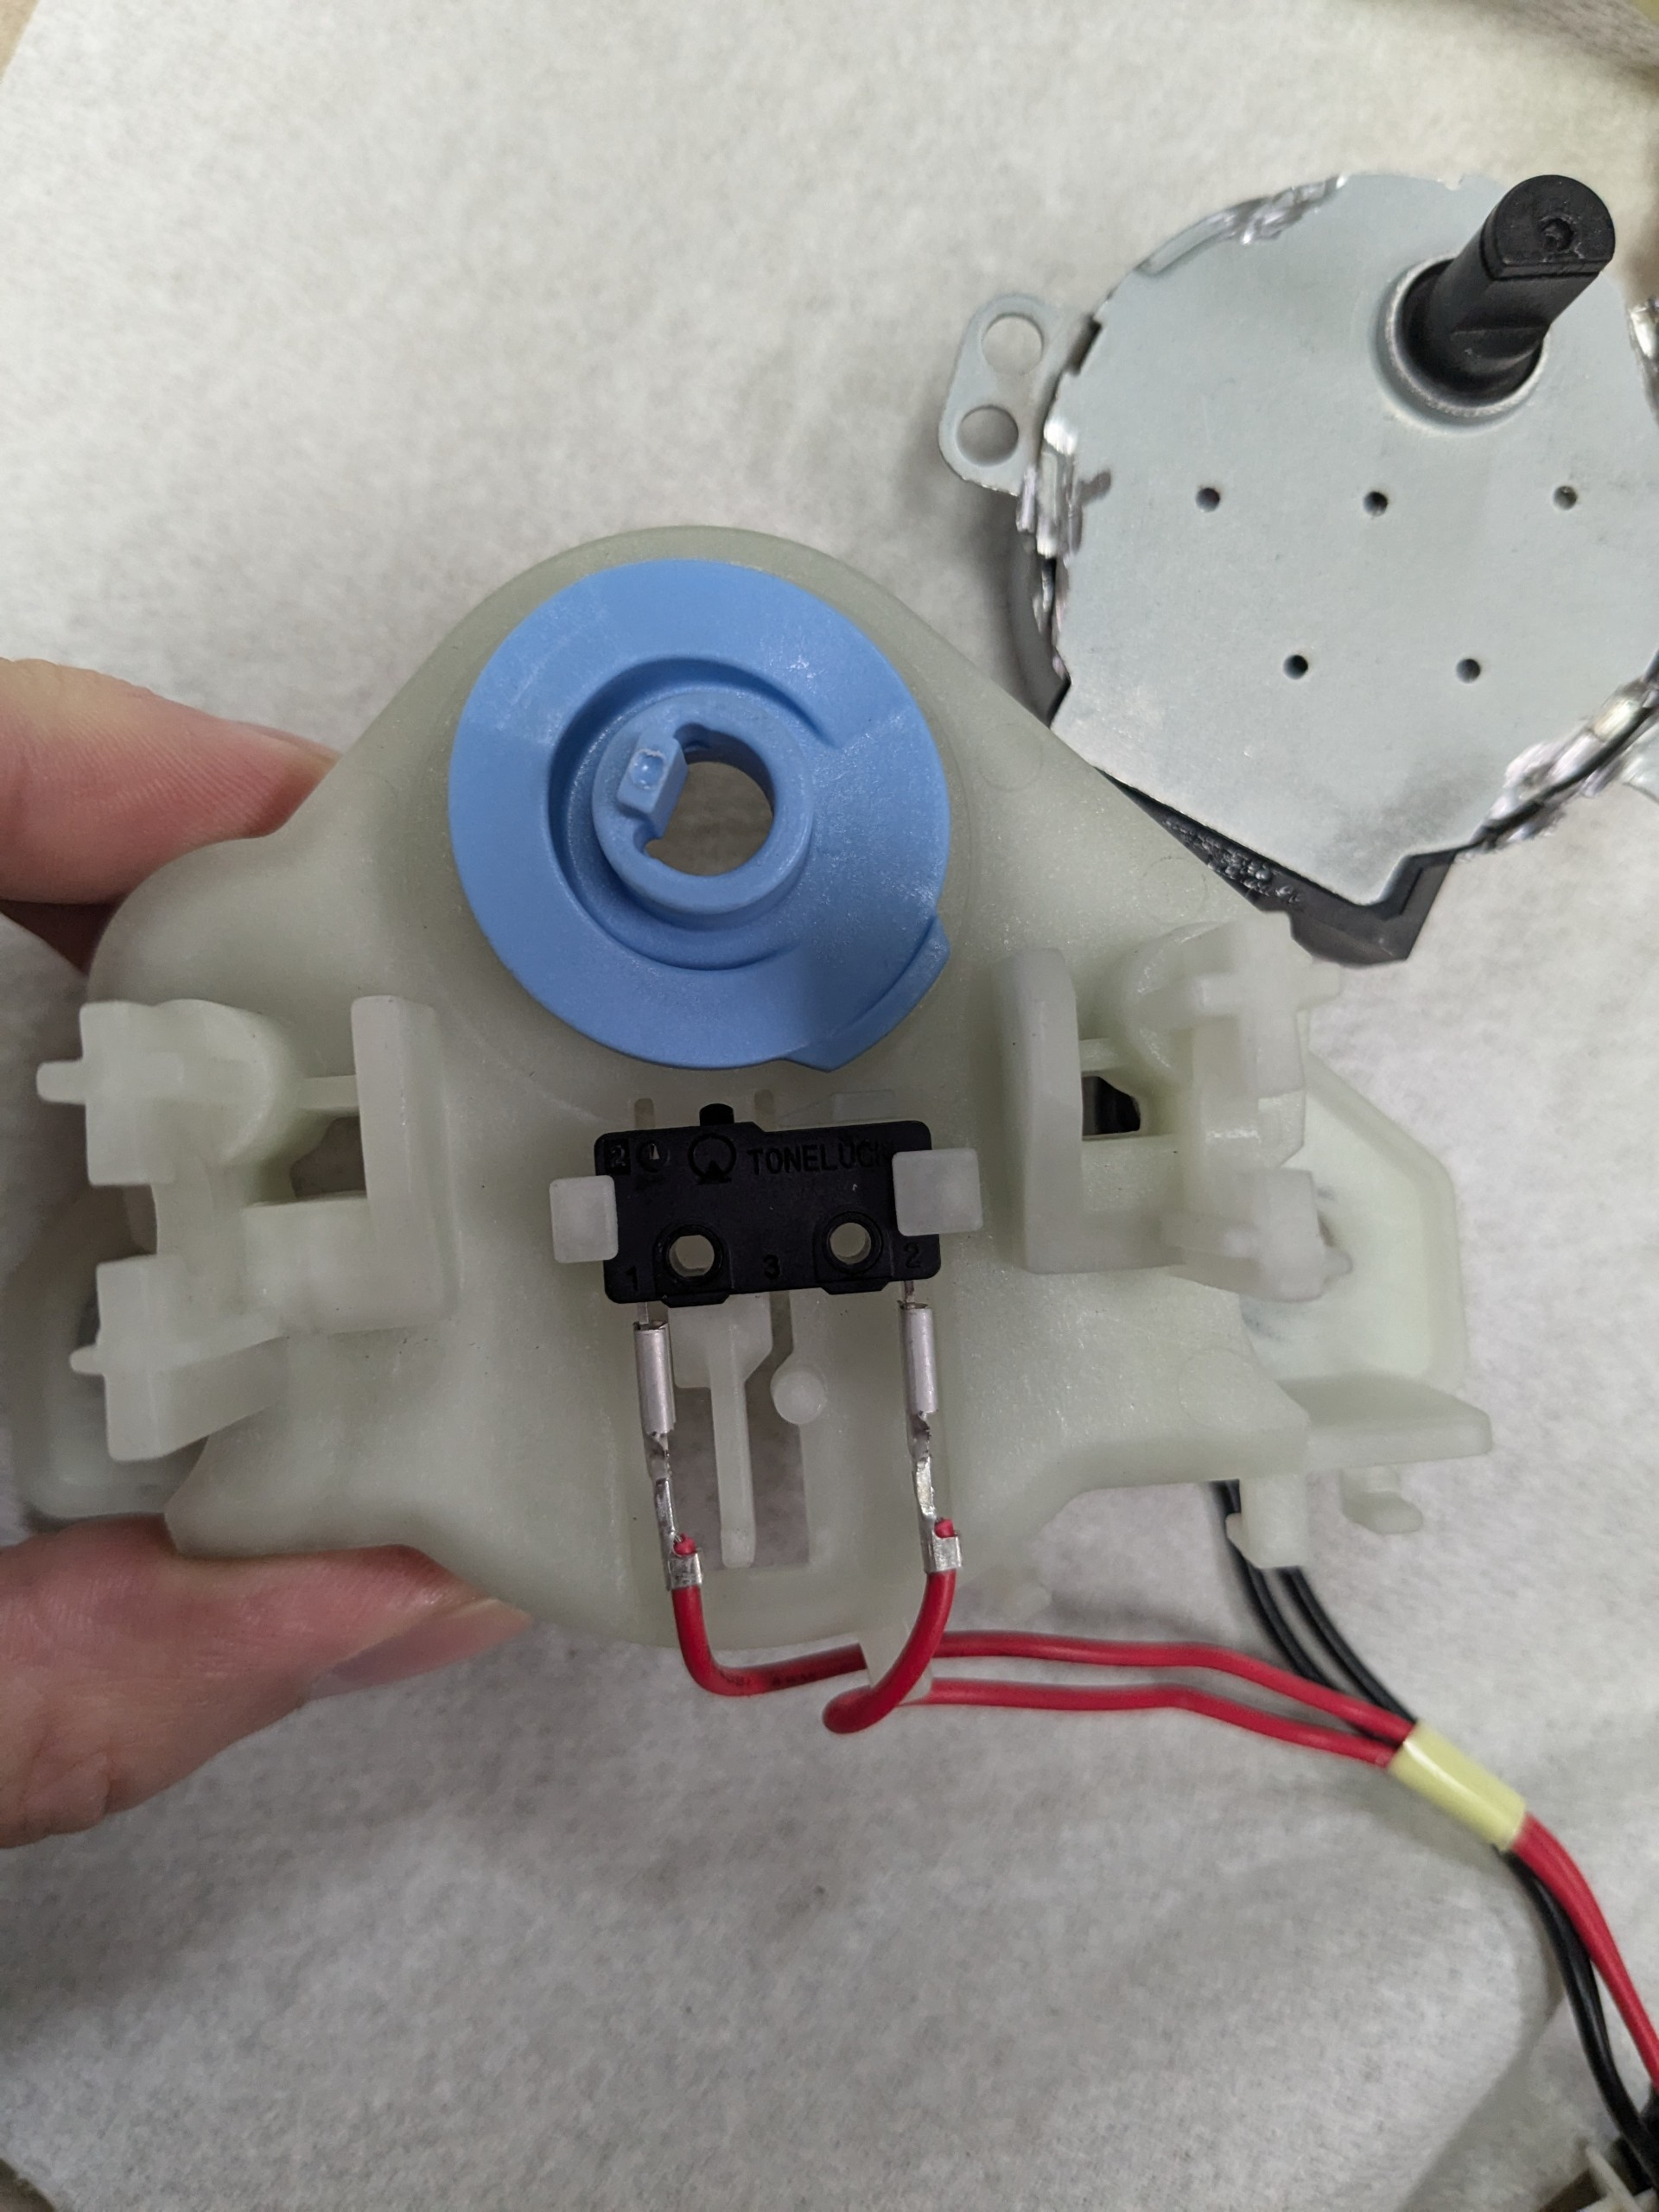
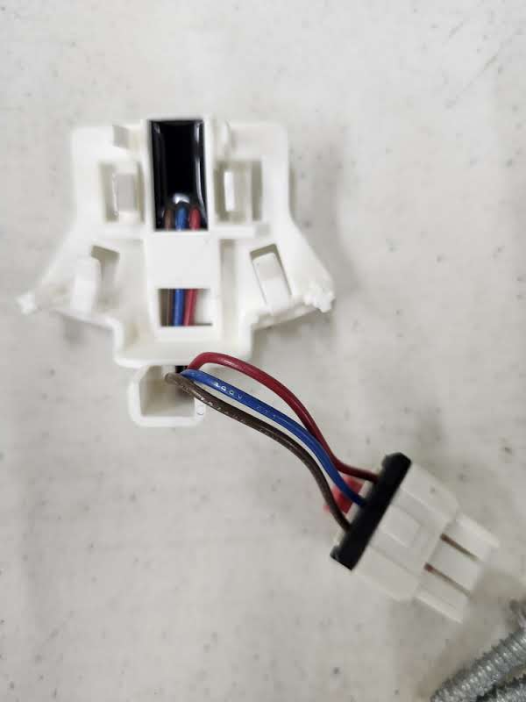
Sensors
We only found 3 sensors in the dishwasher
Speed sensor to tell the motor speed
A pressure sensor mounted directly to the main control board
A switch that tells the position of the clutch

Slide 8
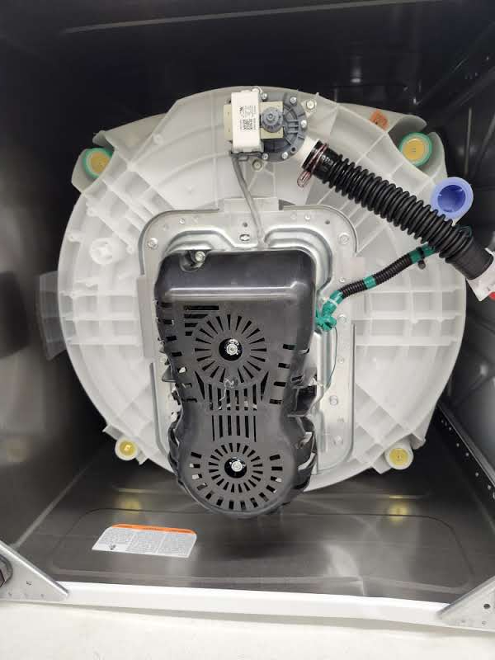
Drain Pump
The Drain pump mounted to the tub
The drain pump sits at the bottom of the Plastic Tub
Much thicker stack than dishwasher drain pump

Slide 9
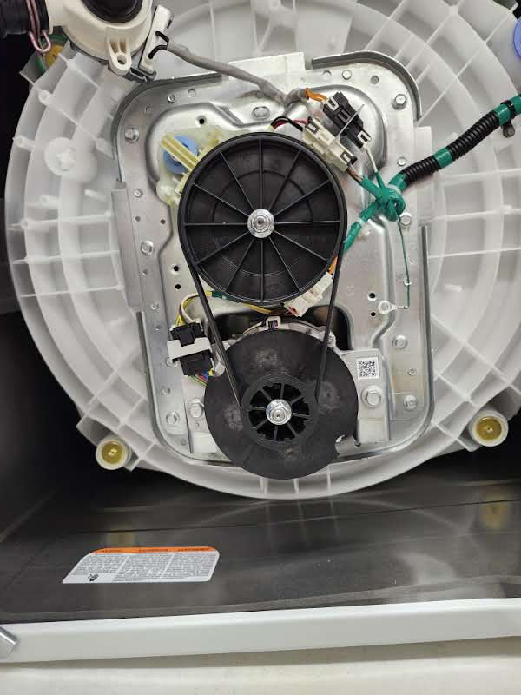
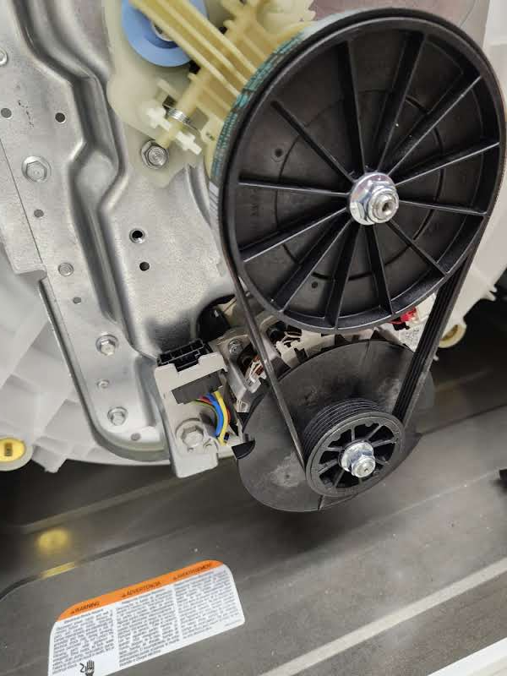
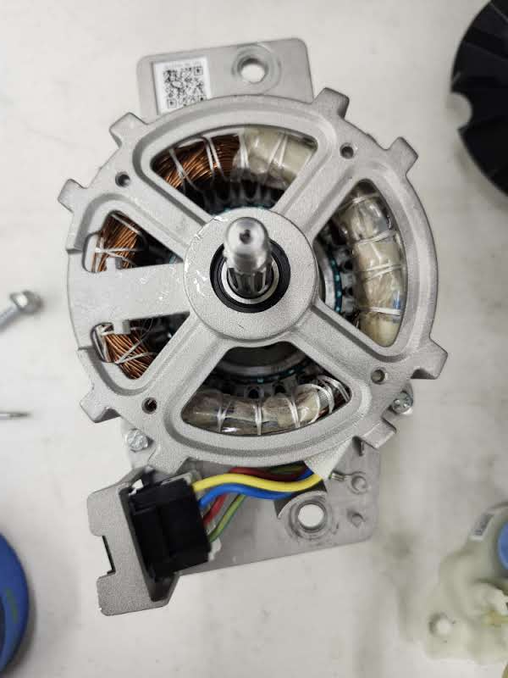
Drive motor
Drive motor connects via a belt to the gearbox
3 Phase AC motor?
The Drive motor (green) and the gearbox and drum connection (red)

Slide 10
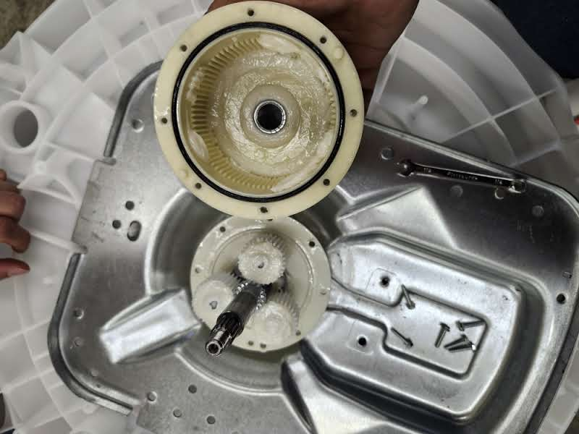
Gearbox
Connected to the drive motor by a pulley
Planetary gearbox with 3 planets

Slide 11
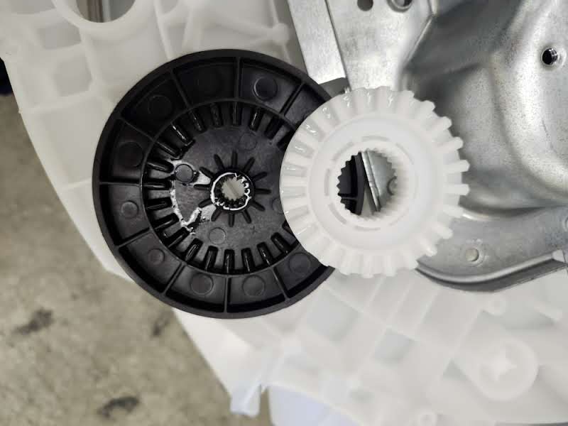
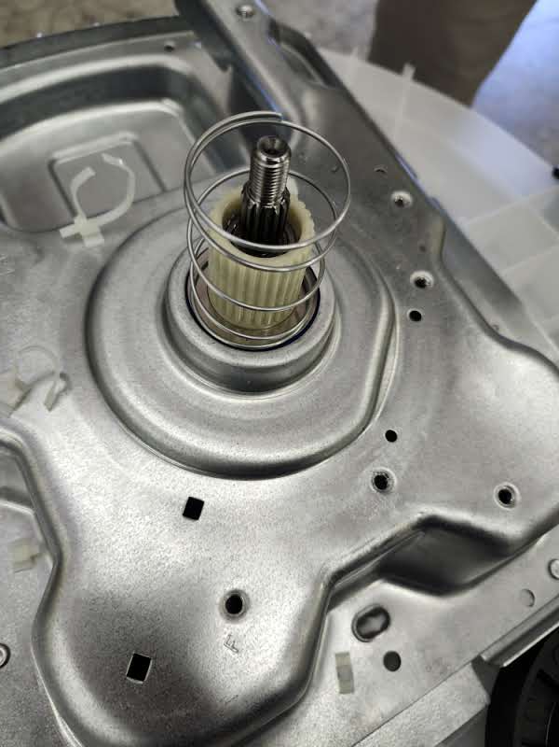
Clutch
The clutch is engaged by a rotating disk spun by an AC motor
During normal operation only the agitator spins
When the clutch is engaged both the agitator and the drum spin
The White disk is pushed up by the actuation arm and then forced back down by the spring

Slide 12
Flow Diagram
Pressure Sensor
Wash Drum
Water line
Inlet
Drain Pump
Drain

Slide 13
Improvement Ideas
BLDC drive instead of AC
One unit motor and gearbox to drive the drum
Standardized inlet valve across the GE appliance Line
Switch the machine to mainly DC, more energy efficient and quieter

